Slide 1
Potential Outcomes & Causality

Slide 2
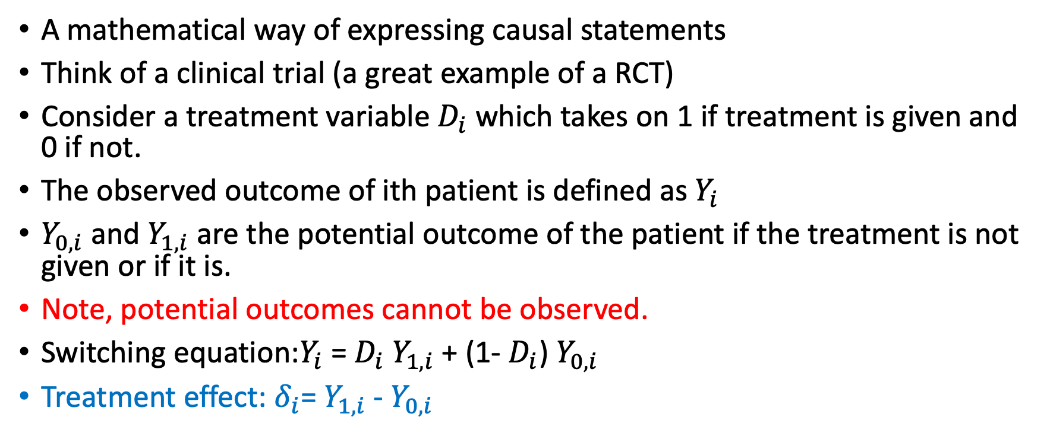
What is potential outcomes
A mathematical way of expressing causal statements
Think of a clinical trial (a great example of a RCT)
Consider a treatment variable $D_{i}$ which takes on 1 if treatment is given and 0 if not.
The observed outcome of ith patient is defined as $Y_{i}$
$Y_{0, i}$ and $Y_{1, i}$ are the potential outcome of the patient if the treatment is not given or if it is.
Note, potential outcomes cannot be observed.
Switching equation:$Y_{i}$ = $D_{i}$ $Y_{1, i}$ + (1- $D_{i}$) $Y_{0, i}$
Treatment effect: $δ_{i}$= $Y_{1, i}$ - $Y_{0, i}$

Slide 3
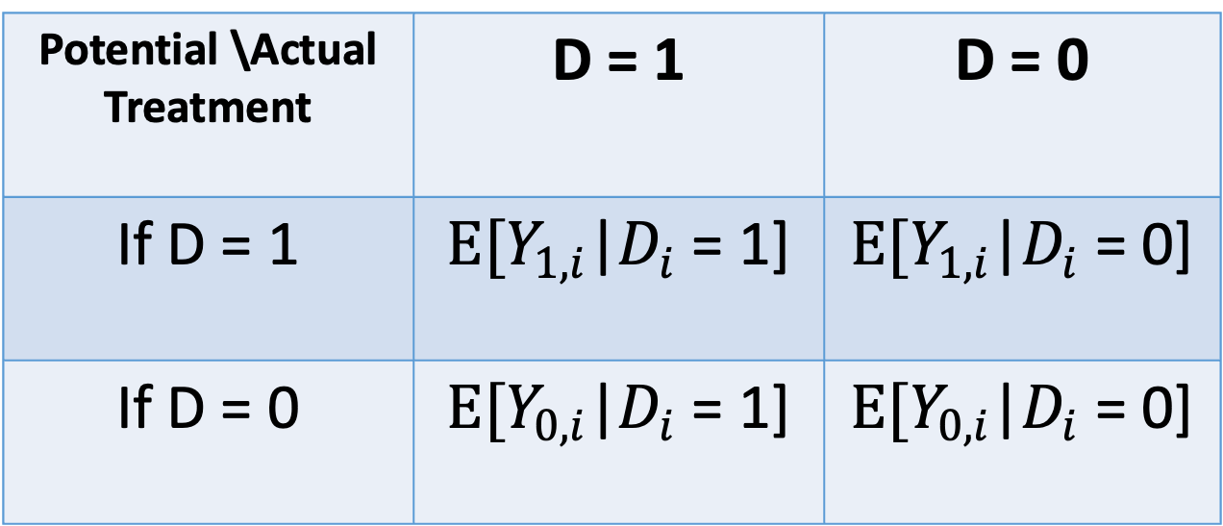
What is potential outcomes
Potential \Actual Treatment | D = 1 | D = 0
If D = 1 | $E[Y_{1, i}$|$D_{i}$ = 1] | $E[Y_{1, i}$|$D_{i}$ = 0]
If D = 0 | $E[Y_{0, i}$|$D_{i}$ = 1] | $E[Y_{0, i}$|$D_{i}$ = 0]

Slide 4
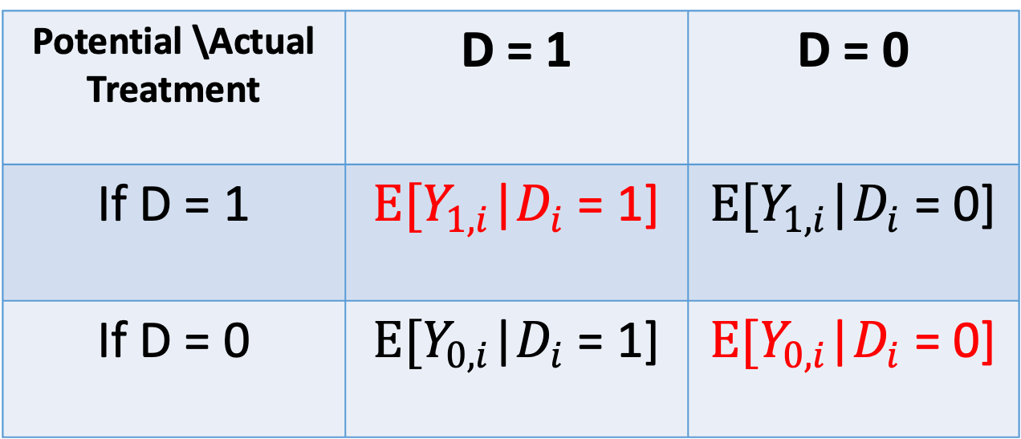
What is potential outcomes
Potential \Actual Treatment | D = 1 | D = 0
If D = 1 | $E[Y_{1, i}$|$D_{i}$ = 1] | $E[Y_{1, i}$|$D_{i}$ = 0]
If D = 0 | $E[Y_{0, i}$|$D_{i}$ = 1] | $E[Y_{0, i}$|$D_{i}$ = 0]

Slide 5
What is potential outcomes
Potential \Actual Treatment | D = 1 | D = 0
If D = 1 | $E[Y_{1, i}$|$D_{i}$ = 1] | $E[Y_{1, i}$|$D_{i}$ = 0]
If D = 0 | $E[Y_{0, i}$|$D_{i}$ = 1] | $E[Y_{0, i}$|$D_{i}$ = 0]
-
= ATT
= ATU

Slide 6
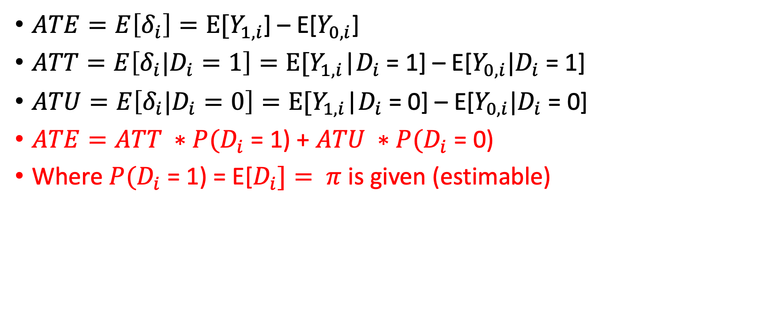
What is potential outcomes
$ATE=E\left[δ_{i}\right]=E[Y_{1, i}$] – E[$Y_{0, i}$]
$ATT=E\left[δ_{i}|D_{i}=1\right]=E[Y_{1, i}$|$D_{i}$ = 1] – E[$Y_{0, i}|D_{i}$ = 1]
$ATU=E\left[δ_{i}|D_{i}=0\right]=E[Y_{1, i}$|$D_{i}$ = 0] – E[$Y_{0, i}|D_{i}$ = 0]
$ATE=ATT ∗P(D_{i}$ = 1) + $ATU ∗P(D_{i}$ = 0)
Where $P(D_{i}$ = 1) = E[$D_{i}]= π$ is given (estimable)

Slide 7
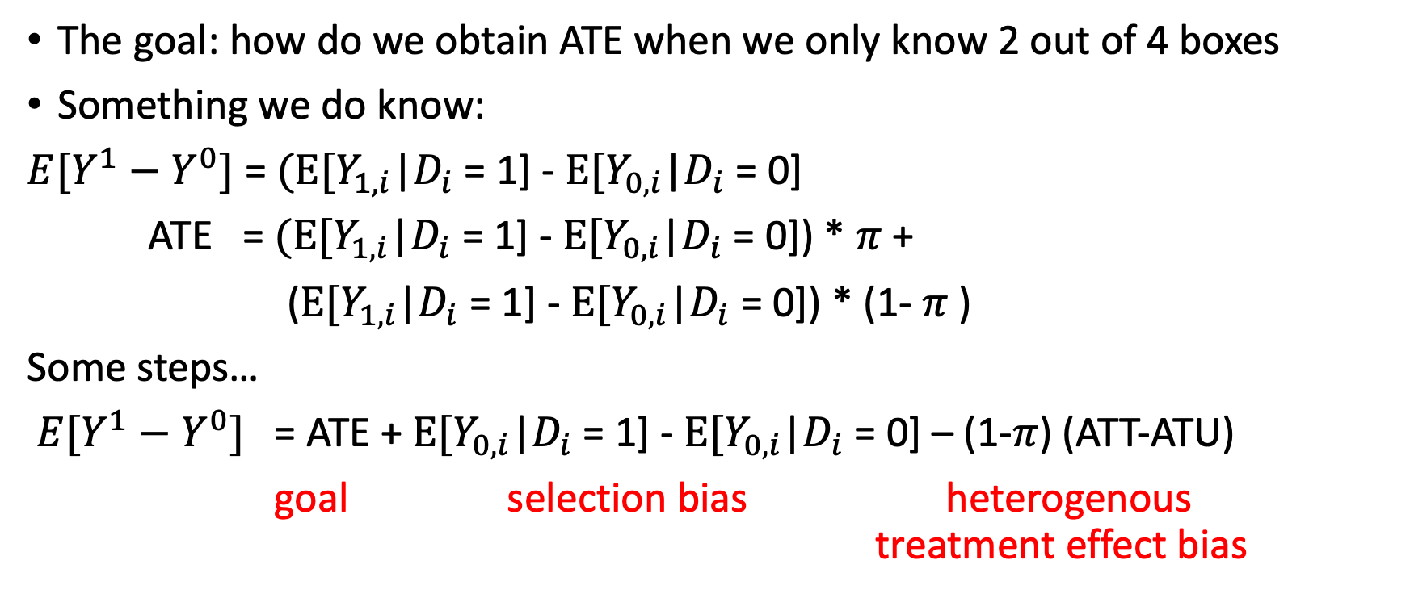
Why do we care
The goal: how do we obtain ATE when we only know 2 out of 4 boxes
Something we do know:
$E[Y^{1}−Y^{0}]$ = $(E[Y_{1, i}$|$D_{i}$ = 1] - $E[Y_{0, i}$|$D_{i}$ = 0]
ATE = $(E[Y_{1, i}$|$D_{i}$ = 1] - $E[Y_{0, i}$|$D_{i}$ = 0]) * $π$ +
($E[Y_{1, i}$|$D_{i}$ = 1] - $E[Y_{0, i}$|$D_{i}$ = 0]) * (1- $π$ )
Some steps…
$E[Y^{1}−Y^{0}]$ = ATE + $E[Y_{0, i}$|$D_{i}$ = 1] - $E[Y_{0, i}$|$D_{i}$ = 0] – (1-$π$) (ATT-ATU)
goal selection bias heterogenous treatment effect bias

Slide 8
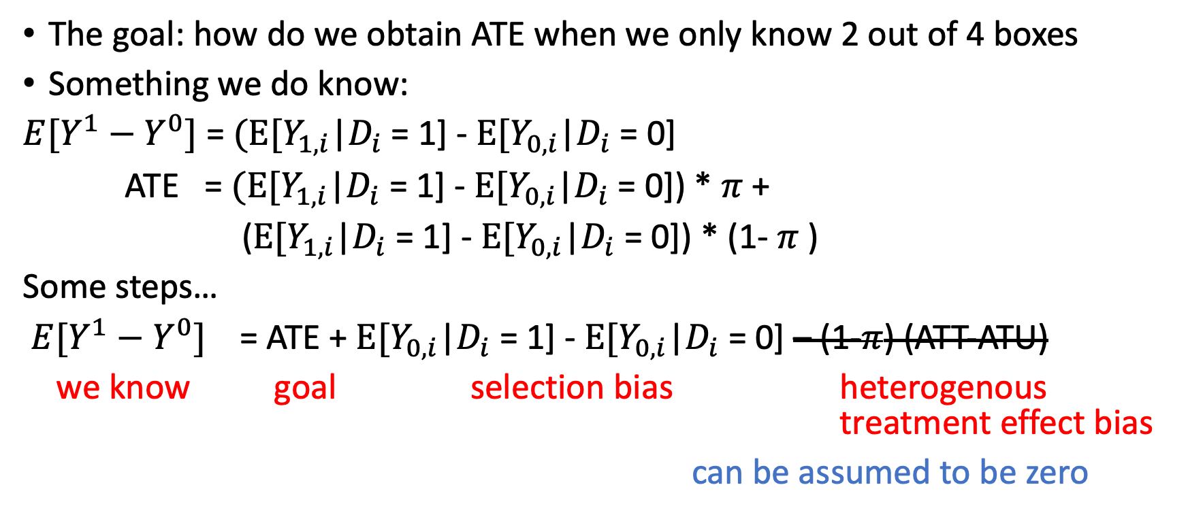
Why do we care
The goal: how do we obtain ATE when we only know 2 out of 4 boxes
Something we do know:
$E[Y^{1}−Y^{0}]$ = $(E[Y_{1, i}$|$D_{i}$ = 1] - $E[Y_{0, i}$|$D_{i}$ = 0]
ATE = $(E[Y_{1, i}$|$D_{i}$ = 1] - $E[Y_{0, i}$|$D_{i}$ = 0]) * $π$ +
($E[Y_{1, i}$|$D_{i}$ = 1] - $E[Y_{0, i}$|$D_{i}$ = 0]) * (1- $π$ )
Some steps…
$E[Y^{1}−Y^{0}]$ = ATE + $E[Y_{0, i}$|$D_{i}$ = 1] - $E[Y_{0, i}$|$D_{i}$ = 0] – (1-$π$) (ATT-ATU)
we know goal selection bias heterogenous treatment effect bias
can be assumed to be zero

Slide 9
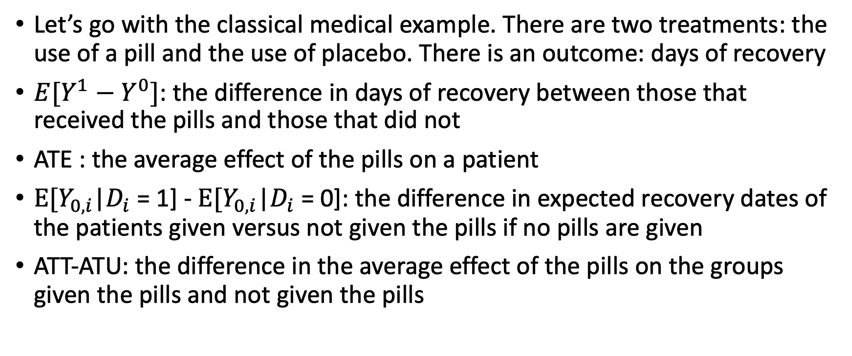
A little more concrete example
Let’s go with the classical medical example. There are two treatments: the use of a pill and the use of placebo. There is an outcome: days of recovery
$E[Y^{1}−Y^{0}]$: the difference in days of recovery between those that received the pills and those that did not
ATE : the average effect of the pills on a patient
$E[Y_{0, i}$|$D_{i}$ = 1] - $E[Y_{0, i}$|$D_{i}$ = 0]: the difference in expected recovery dates of the patients given versus not given the pills if no pills are given
ATT-ATU: the difference in the average effect of the pills on the groups given the pills and not given the pills

Slide 10

So what assumptions do we want to make
Independence:${ (Y}^{1},Y^{0})⊥D$
What this means: $P(Y$=a| $D$=1) = $P(Y$=a| $D$=0)
=> $E[Y_{0, i}$|$D_{i}$ = 1] - $E[Y_{0, i}$|$D_{i}$ = 0]=0
=> ATE = $E[Y^{1}−Y^{0}]$

Slide 11
Stable unit treatment value assumptions
Homogenous treatment (the same pills are given)
No Spillover effect (e.g. general equilibrium)

Slide 12
How to test this
Economic theory
Descriptive statistics on possible controls

